Slide 1
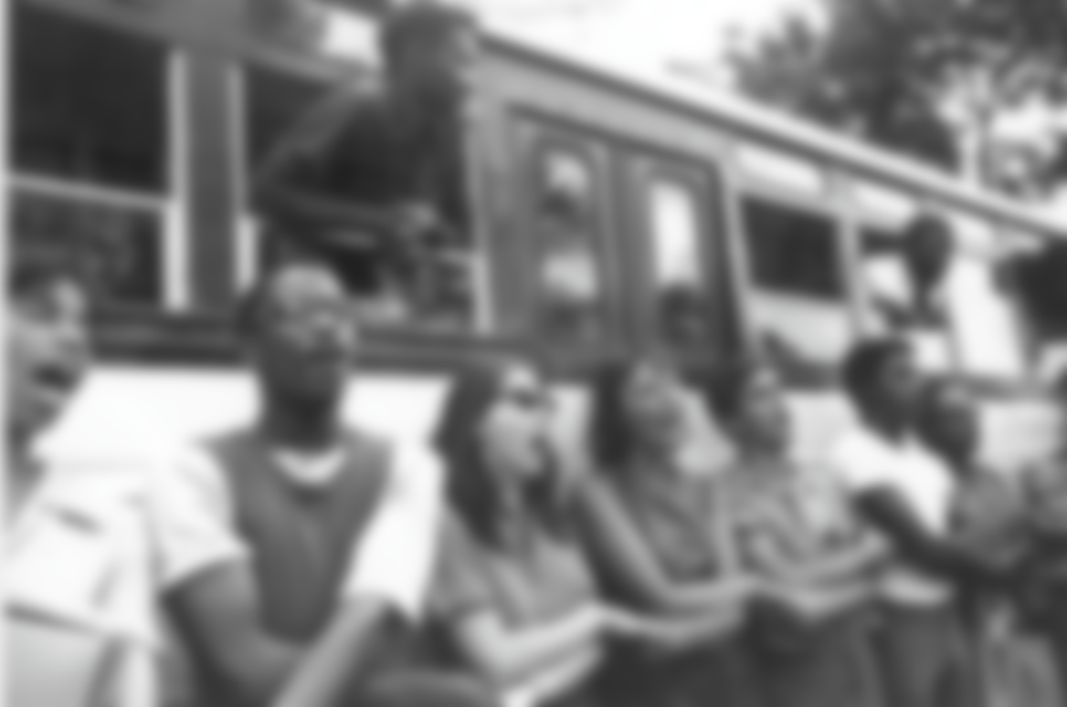
Problematic :
FREEDOM RIDERS
How did Freedom Rides movement make a difference against racism ?
ANDREA / BAPTISTE

Slide 2





SOMMAIRE
Historical Context
Problematic :
Origins
How did Freedom Rides movement make a difference against racism ?
Actions
Legacy
Conclusion

Slide 3
SUMMARY
Historical Context
Origins
Actions
Legacy
Conclusion

Slide 4


Slide 5
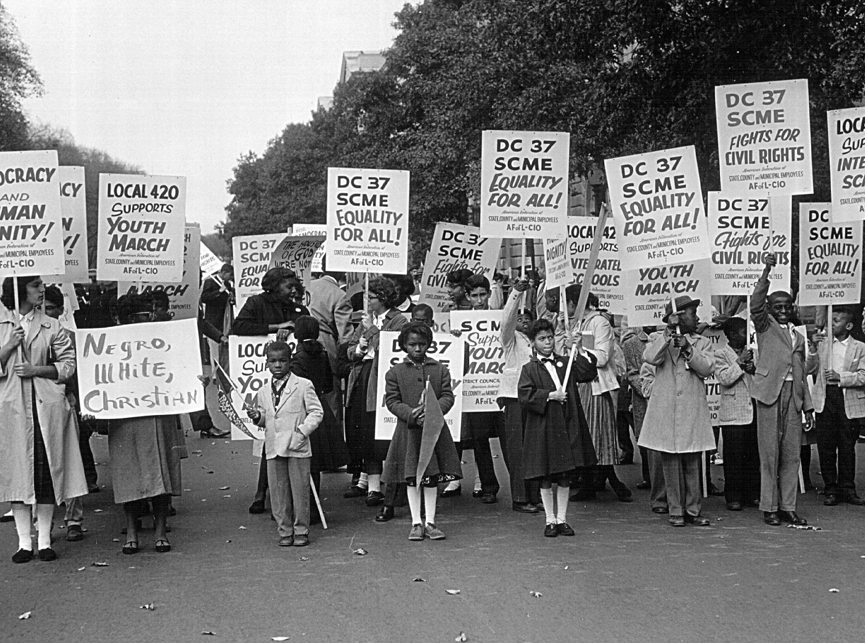

Slide 6
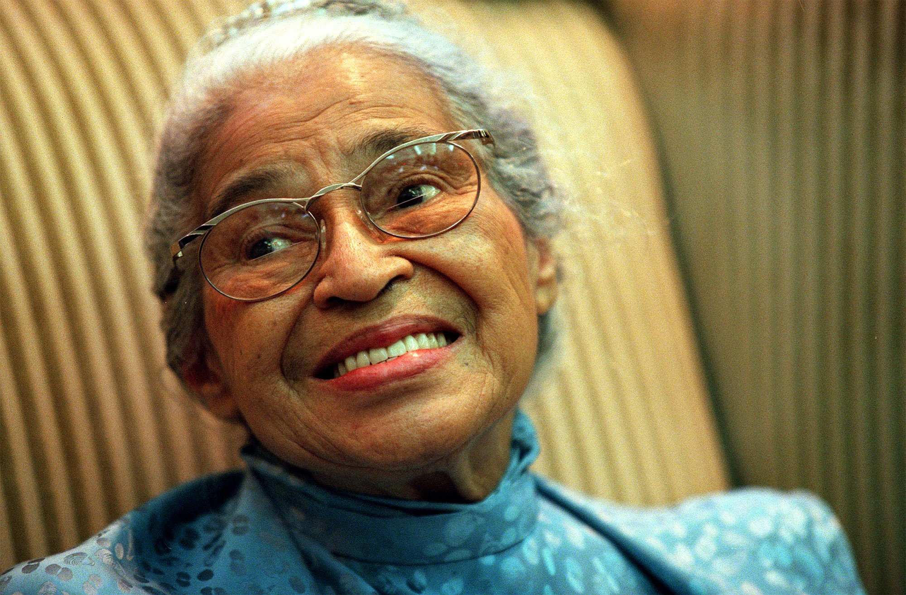

Slide 7
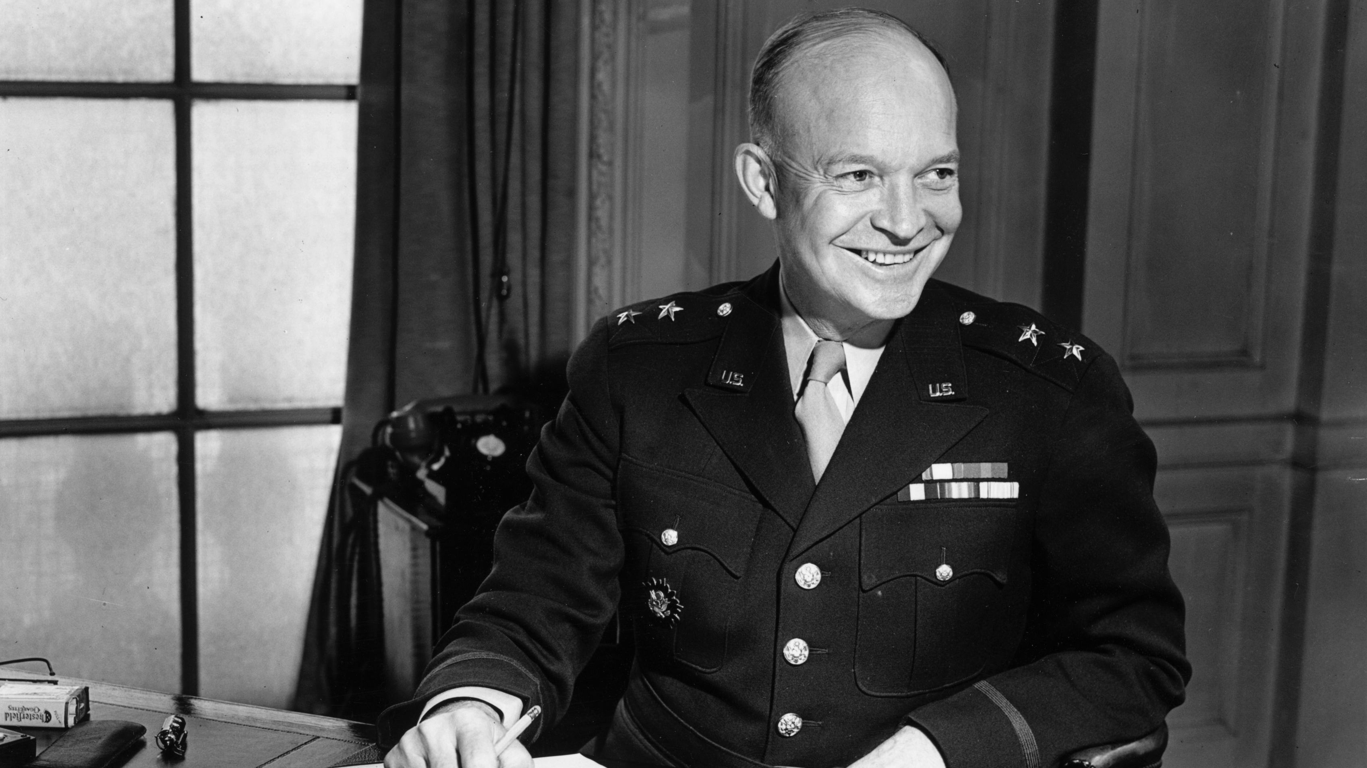

Slide 8


Slide 9
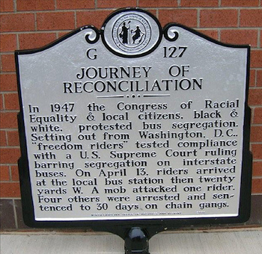

Slide 10

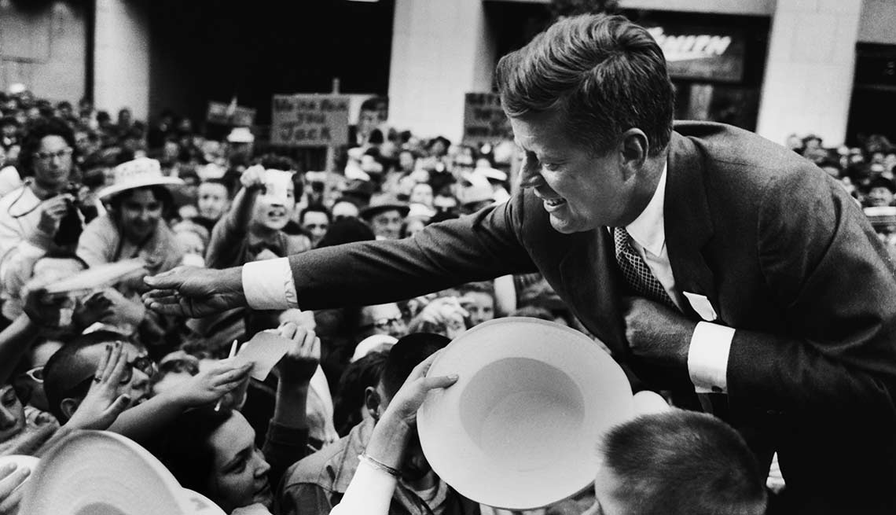

Slide 11


Slide 12
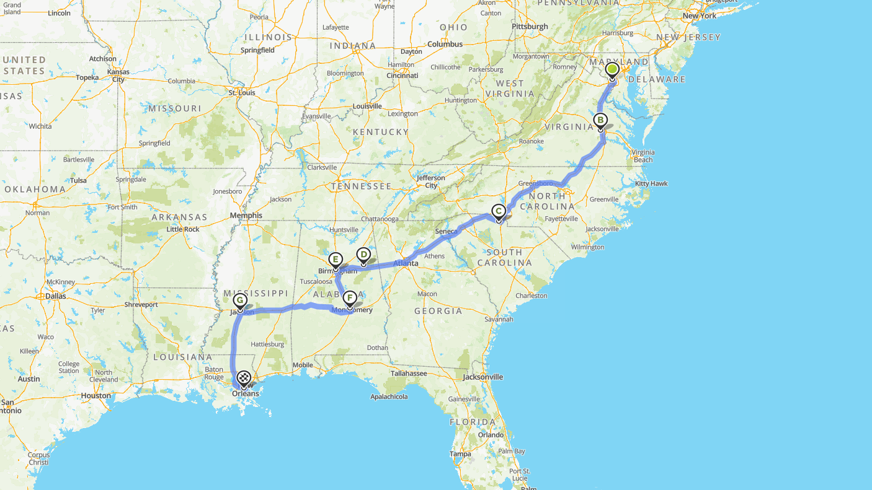
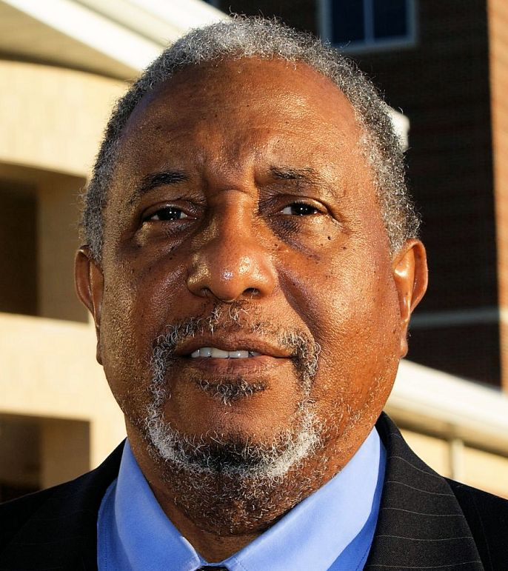
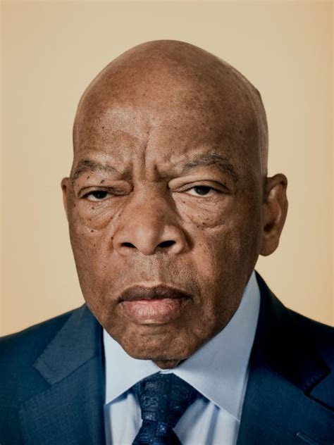
WASHINGTON D.C
13 B/W Men and Women
Trip to New Orleans
Supreme Court Decision

Slide 13
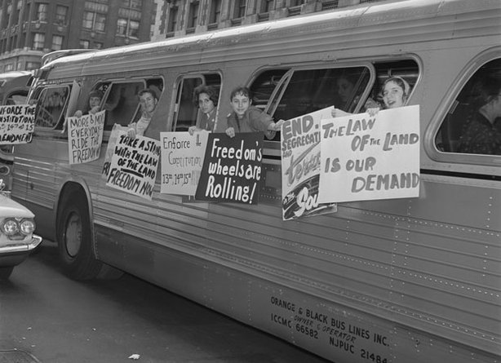
MAY 4 1961
WASHINGTON D.C
13 B/W Men and Women
Trip to New Orleans
Supreme Court Decision

Slide 14
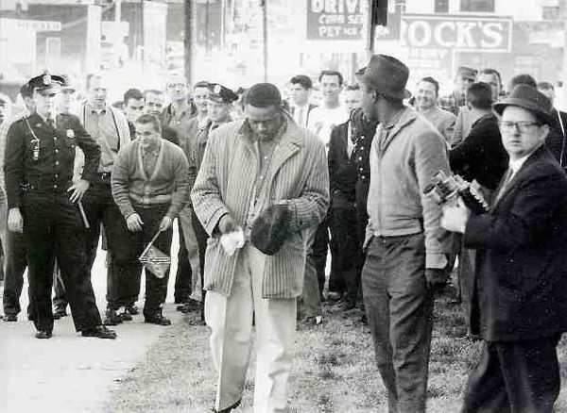
ROCK HILL
MAY 4 1961
WASHINGTON D.C
13 B/W Men and Women
Trip to New Orleans
Supreme Court Decision

Slide 15
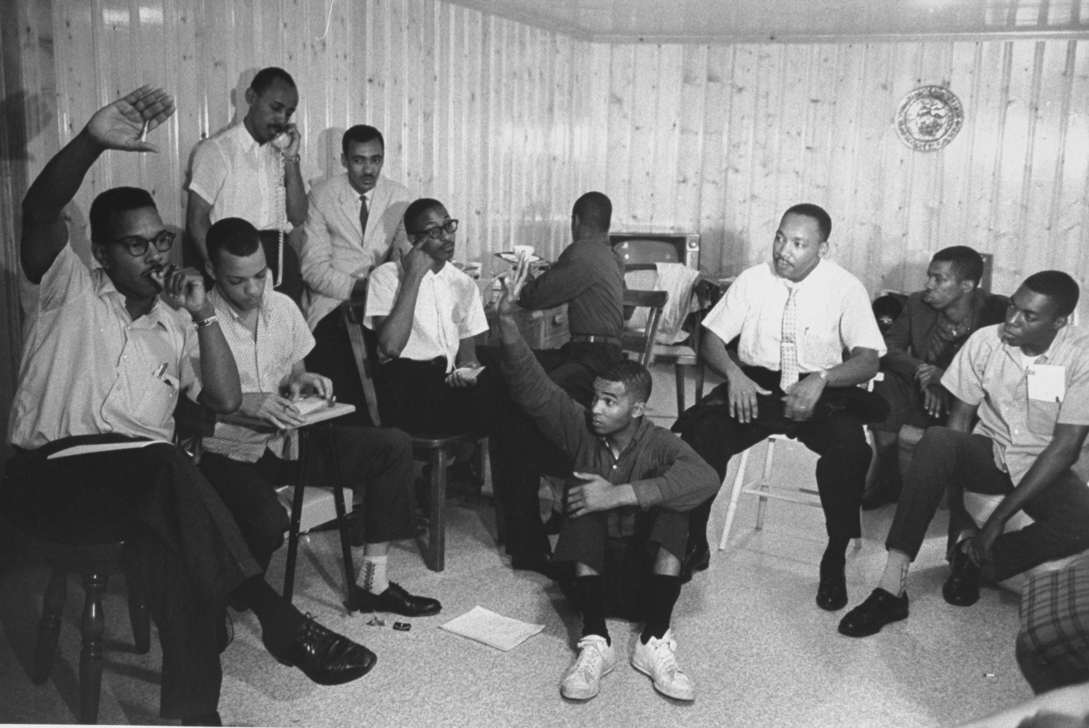
ROCK HILL
« You will never make it through Alabama ! »

Slide 16
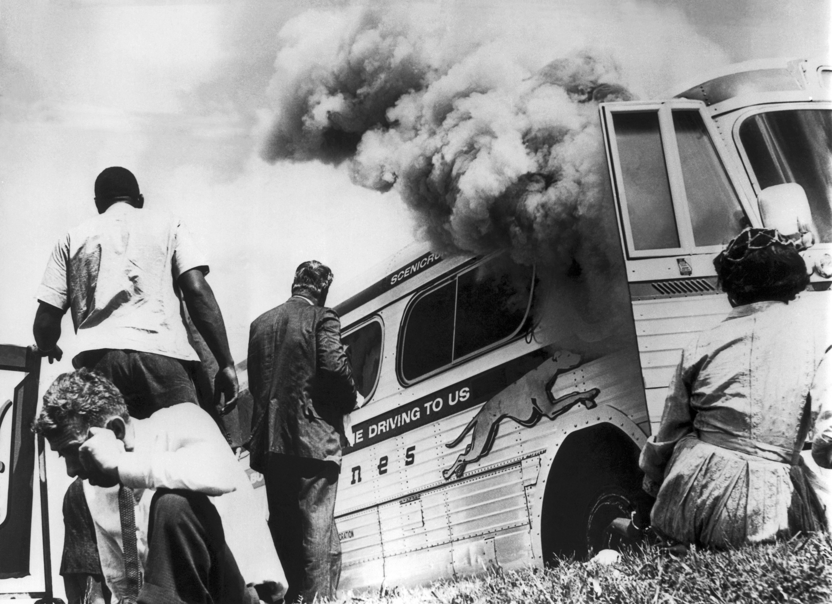
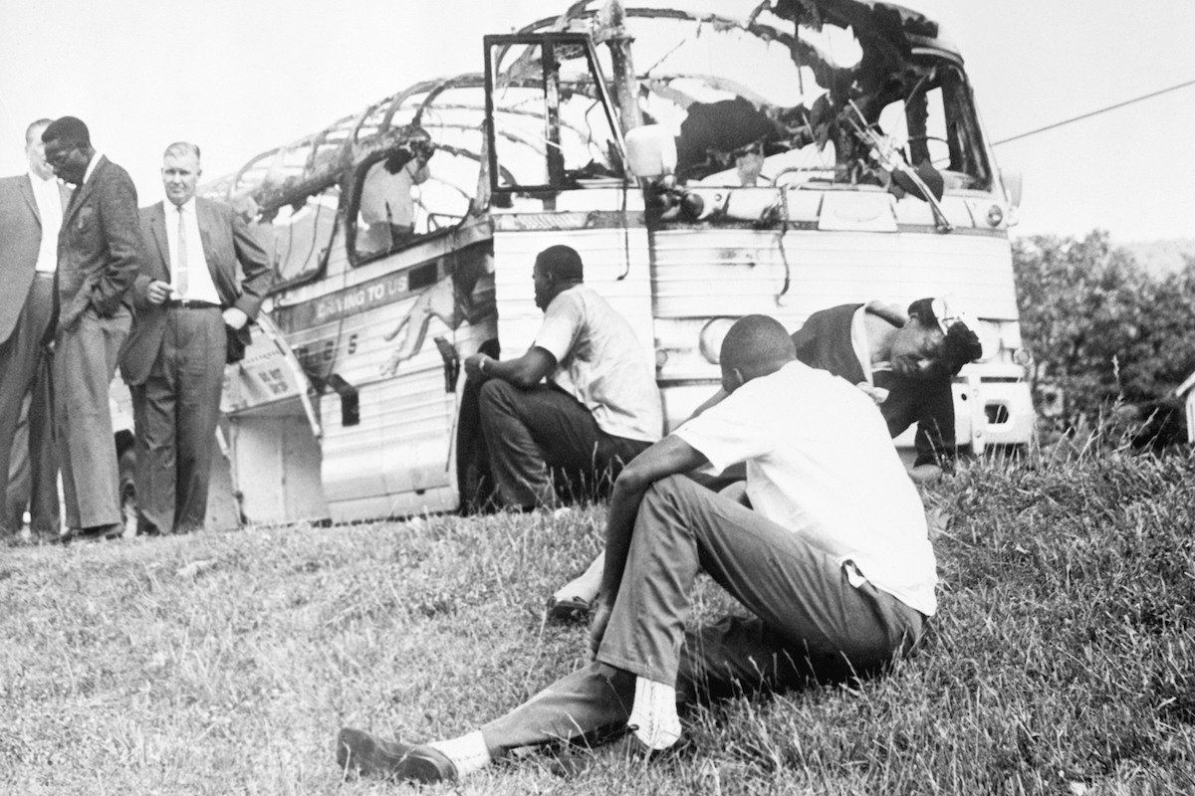
MAY 14 1961
ANNISTON
ROCK HILL
« You will never make it through Alabama ! »

Slide 17
BIRMINGAM
MAY 14 1961
ANNISTON
« You will never make it through Alabama ! »

Slide 18
BIRMINGAM
MAY 14 1961
ANNISTON
JACKSON

Slide 19
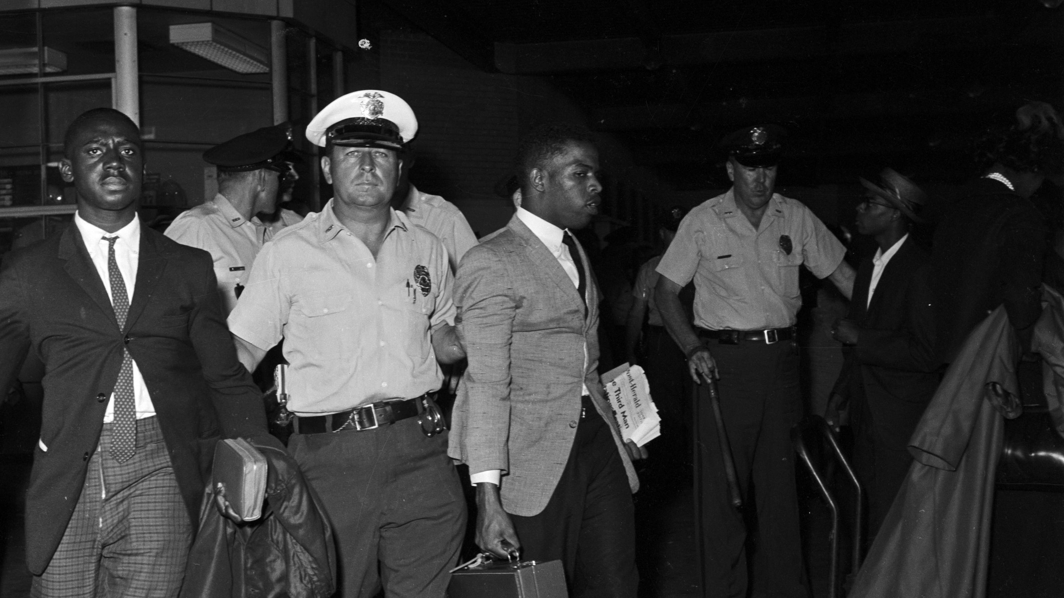
BIRMINGAM
JACKSON

Slide 20
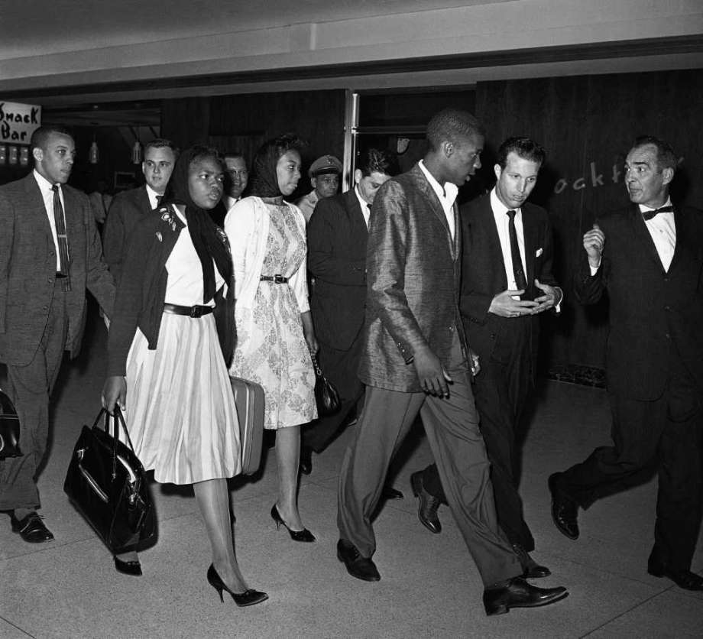

Slide 21
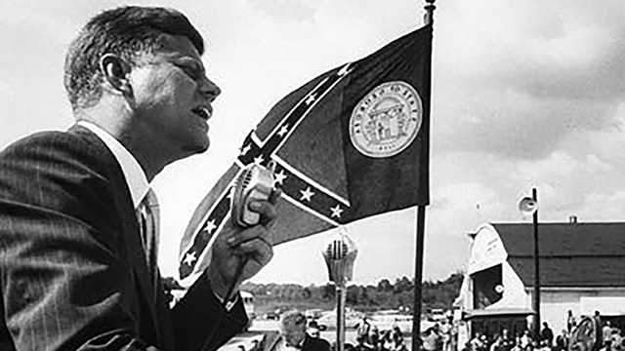
- Pressuring the ICC
- Became illegal
the November 1, 1961
- 1964 Outlawed segregation in all public spaces

Slide 22
- Pressuring the ICC
- Became illegal
the November 1, 1961
- 1964 Outlawed segregation in all public spaces

Slide 23

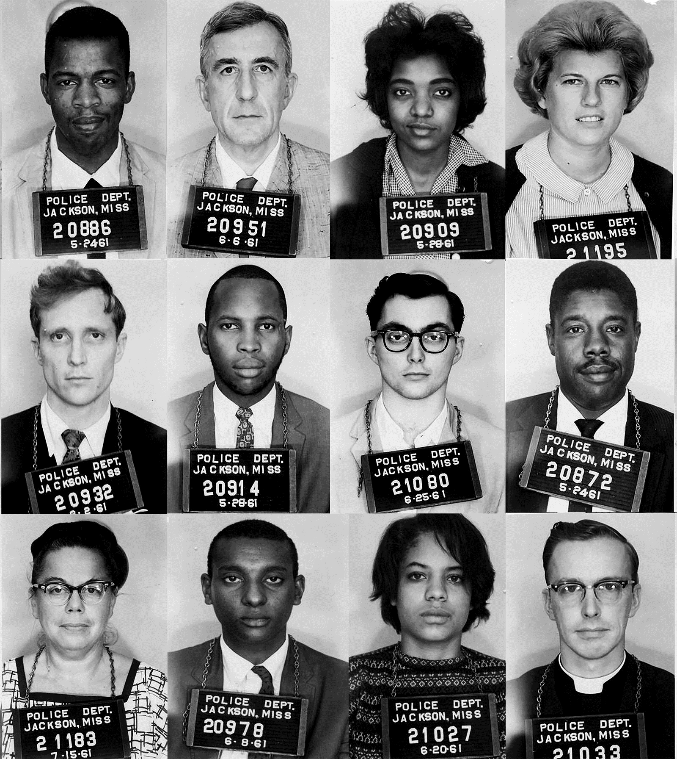
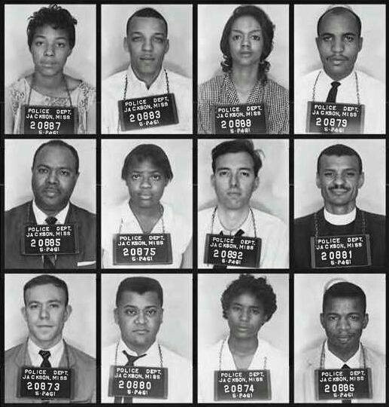

Slide 24
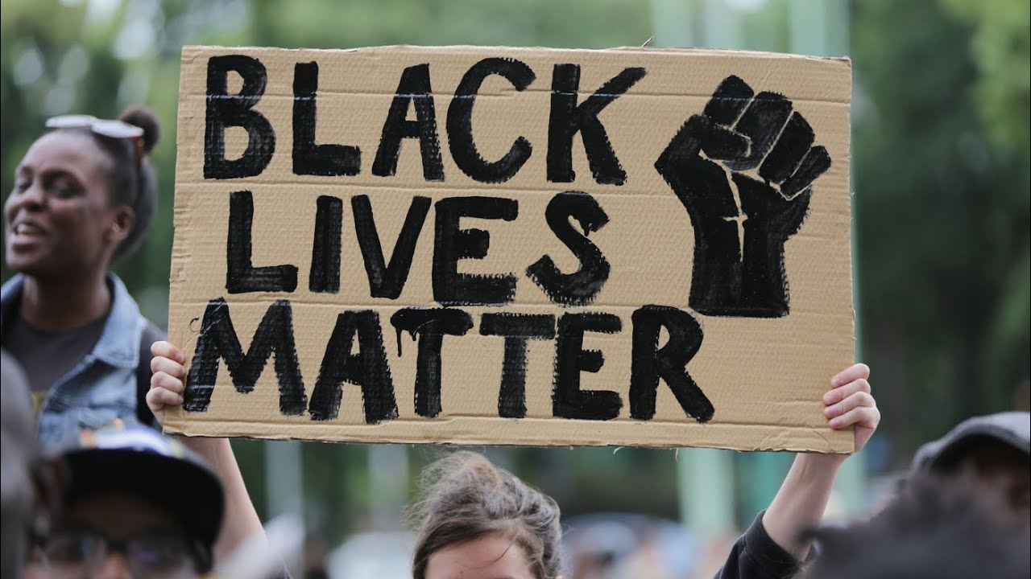

Slide 25
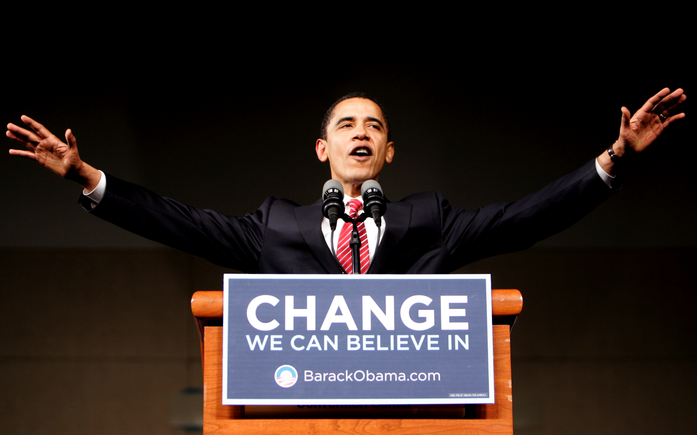

Slide 26
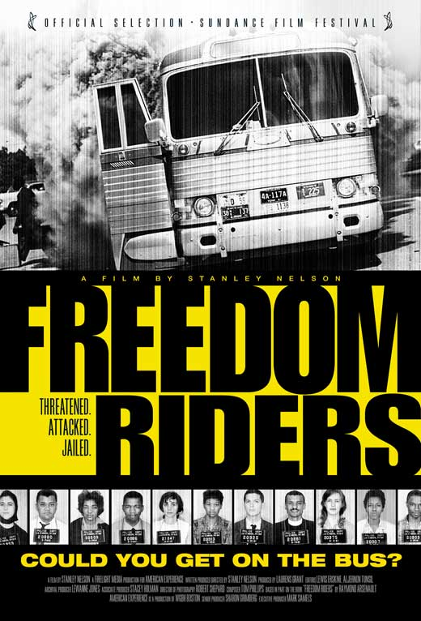
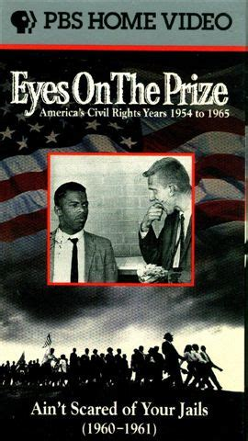

Slide 28


Slide 29
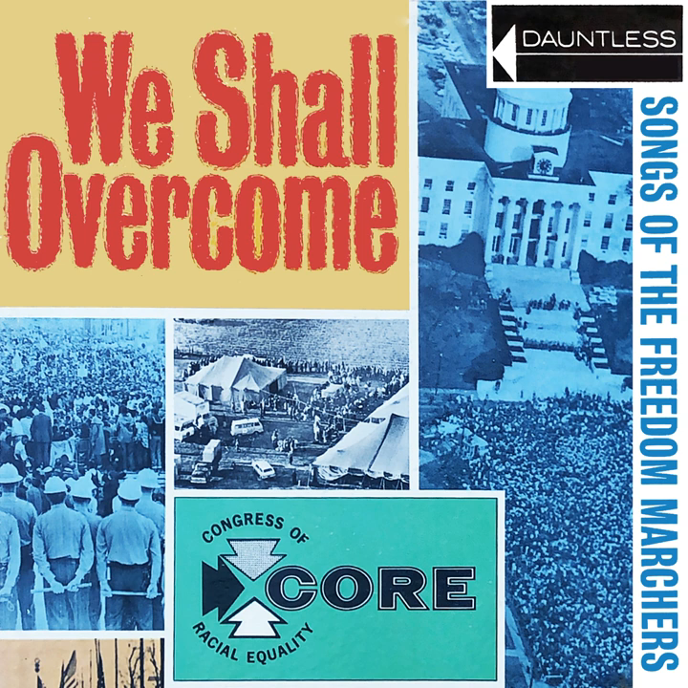
CONCLUSION
Hallelujah I’m a Travelin’ :
In 1954, The Supreme Court has said :
"Listen here Mr. Jim Crow, it's time you were dead"
Hallelujah, I'm a travelin', hallelujah, ain't it fine?
Hallelujah, I'm a-traveling down freedom's main line
In all Johnson one day, we were all buy a coke
And the waitress who serve us, who know is no joke
Hallelujah, I'm a travelin', hallelujah, ain't it fine?
Hallelujah, I'm a-traveling down freedom's main line
I'm taking a trip, on the grey on bus line
I'm riding the front seat to Jackson this time
Hallelujah, I'm a travelin', hallelujah, ain't it fine?
Hallelujah, I'm a-traveling down freedom's main line
The power is now open, for the Negros to vote
Hallelujah, I'm a travelin', hallelujah, ain't it fine?
Hallelujah, I'm a-traveling down freedom's main line
300 Freedom Riders with no other choice
6 miles, 300$, responded, man and boys
Hallelujah, I'm a travelin', hallelujah, ain't it fine?
Hallelujah, I'm a-traveling down freedom's main line
Hallelujah, I'm a travelin', hallelujah, ain't it fine?
Hallelujah, I'm a-traveling down freedom's main line

Slide 30
CONCLUSION
Hallelujah I’m a Travelin’ :
In 1954, The Supreme Court has said :
"Listen here Mr. Jim Crow, it's time you were dead"
Hallelujah, I'm a travelin', hallelujah, ain't it fine?
Hallelujah, I'm a-traveling down freedom's main line
In all Johnson one day, we were all buy a coke
And the waitress who serve us, who know is no joke
Hallelujah, I'm a travelin', hallelujah, ain't it fine?
Hallelujah, I'm a-traveling down freedom's main line
I'm taking a trip, on the grey on bus line
I'm riding the front seat to Jackson this time
Hallelujah, I'm a travelin', hallelujah, ain't it fine?
Hallelujah, I'm a-traveling down freedom's main line
The power is now open, for the Negros to vote
Hallelujah, I'm a travelin', hallelujah, ain't it fine?
Hallelujah, I'm a-traveling down freedom's main line
300 Freedom Riders with no other choice
6 miles, 300$, responded, man and boys
Hallelujah, I'm a travelin', hallelujah, ain't it fine?
Hallelujah, I'm a-traveling down freedom's main line
Hallelujah, I'm a travelin', hallelujah, ain't it fine?
Hallelujah, I'm a-traveling down freedom's main line

Slide 31
CONCLUSION
Hallelujah I’m a Travelin’ :
In 1954, The Supreme Court has said :
"Listen here Mr. Jim Crow, it's time you were dead"
Hallelujah, I'm a travelin', hallelujah, ain't it fine?
Hallelujah, I'm a-traveling down freedom's main line
In all Johnson one day, we were all buy a coke
And the waitress who serve us, who know is no joke
Hallelujah, I'm a travelin', hallelujah, ain't it fine?
Hallelujah, I'm a-traveling down freedom's main line
I'm taking a trip, on the grey on bus line
I'm riding the front seat to Jackson this time
Hallelujah, I'm a travelin', hallelujah, ain't it fine?
Hallelujah, I'm a-traveling down freedom's main line
The power is now open, for the Negros to vote
Hallelujah, I'm a travelin', hallelujah, ain't it fine?
Hallelujah, I'm a-traveling down freedom's main line
300 Freedom Riders with no other choice
6 miles, 300$, responded, man and boys
Hallelujah, I'm a travelin', hallelujah, ain't it fine?
Hallelujah, I'm a-traveling down freedom's main line
Hallelujah, I'm a travelin', hallelujah, ain't it fine?
Hallelujah, I'm a-traveling down freedom's main line

Slide 32
CONCLUSION
Hallelujah I’m a Travelin’ :
In 1954, The Supreme Court has said :
"Listen here Mr. Jim Crow, it's time you were dead"
Hallelujah, I'm a travelin', hallelujah, ain't it fine?
Hallelujah, I'm a-traveling down freedom's main line
In all Johnson one day, we were all buy a coke
And the waitress who serve us, who know is no joke
Hallelujah, I'm a travelin', hallelujah, ain't it fine?
Hallelujah, I'm a-traveling down freedom's main line
I'm taking a trip, on the grey on bus line
I'm riding the front seat to Jackson this time
Hallelujah, I'm a travelin', hallelujah, ain't it fine?
Hallelujah, I'm a-traveling down freedom's main line
The power is now open, for the Negros to vote
Hallelujah, I'm a travelin', hallelujah, ain't it fine?
Hallelujah, I'm a-traveling down freedom's main line
300 Freedom Riders with no other choice
6 miles, 300$, responded, man and boys
Hallelujah, I'm a travelin', hallelujah, ain't it fine?
Hallelujah, I'm a-traveling down freedom's main line
Hallelujah, I'm a travelin', hallelujah, ain't it fine?
Hallelujah, I'm a-traveling down freedom's main line

Slide 33
CONCLUSION
Hallelujah I’m a Travelin’ :
In 1954, The Supreme Court has said :
"Listen here Mr. Jim Crow, it's time you were dead"
Hallelujah, I'm a travelin', hallelujah, ain't it fine?
Hallelujah, I'm a-traveling down freedom's main line
In all Johnson one day, we were all buy a coke
And the waitress who serve us, who know is no joke
Hallelujah, I'm a travelin', hallelujah, ain't it fine?
Hallelujah, I'm a-traveling down freedom's main line
I'm taking a trip, on the grey on bus line
I'm riding the front seat to Jackson this time
Hallelujah, I'm a travelin', hallelujah, ain't it fine?
Hallelujah, I'm a-traveling down freedom's main line
The power is now open, for the Negros to vote
Hallelujah, I'm a travelin', hallelujah, ain't it fine?
Hallelujah, I'm a-traveling down freedom's main line
300 Freedom Riders with no other choice
6 miles, 300$, responded, man and boys
Hallelujah, I'm a travelin', hallelujah, ain't it fine?
Hallelujah, I'm a-traveling down freedom's main line
Hallelujah, I'm a travelin', hallelujah, ain't it fine?
Hallelujah, I'm a-traveling down freedom's main line

Slide 34
CONCLUSION
Hallelujah I’m a Travelin’ :
In 1954, The Supreme Court has said :
"Listen here Mr. Jim Crow, it's time you were dead"
Hallelujah, I'm a travelin', hallelujah, ain't it fine?
Hallelujah, I'm a-traveling down freedom's main line
In all Johnson one day, we were all buy a coke
And the waitress who serve us, who know is no joke
Hallelujah, I'm a travelin', hallelujah, ain't it fine?
Hallelujah, I'm a-traveling down freedom's main line
I'm taking a trip, on the grey on bus line
I'm riding the front seat to Jackson this time
Hallelujah, I'm a travelin', hallelujah, ain't it fine?
Hallelujah, I'm a-traveling down freedom's main line
The power is now open, for the Negros to vote
Hallelujah, I'm a travelin', hallelujah, ain't it fine?
Hallelujah, I'm a-traveling down freedom's main line
300 Freedom Riders with no other choice
6 miles, 300$, responded, man and boys
Hallelujah, I'm a travelin', hallelujah, ain't it fine?
Hallelujah, I'm a-traveling down freedom's main line
Hallelujah, I'm a travelin', hallelujah, ain't it fine?
Hallelujah, I'm a-traveling down freedom's main line

